Slide 1
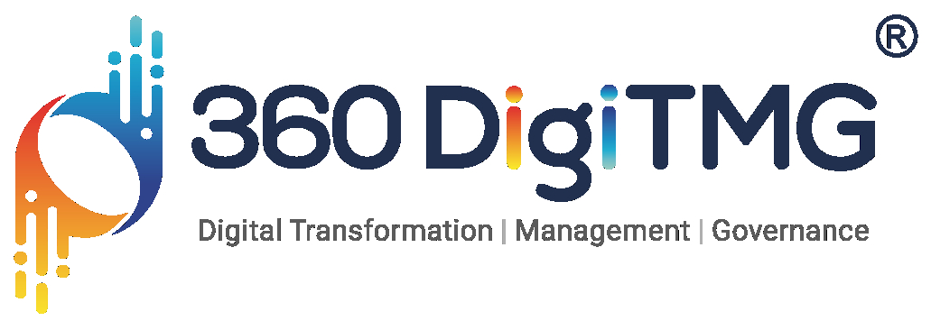

Liver Tumor Classification Using Deep Learning.
Tools : Python , CNN
📂 Overview
The goal is to develop a deep learning model capable of accurately detecting liver tumors from medical imaging scans such as histopathological images.
Data preparation.
Data augmentation.
CNN, Model Building and Deployment.

Slide 2
Contents
Business Objective
Business Constraints
Project Architecture
Data Collection
Exploratory Data Analysis
Data Visualization
Notes:
Change

Slide 3
Business Problem
In the current landscape of liver disease diagnostics, the identification classification of liver tumors present challenges related to accuracy, efficiency and timely intervention. Traditional methods heavily rely on manual interpretation of medical imaging data, leading to potential delays, subjective interpretations and varying levels of expertise across healthcare professionals.
AS a result, there is a critical need to implement AI, in liver tumor classification to addres these challenges and revolutionize the diagnostic process.

Slide 4
Project Overview and Scope
Data Collection: Gather a dataset of histopathological images of liver tissue samples, along with corresponding labels indicating the presence or absence of tumors. Collaborate with medical institutions to collect high-quality, annotated image data.
Model Development: Design and train a deep learning model capable of accurately detecting liver tumors from histopathological images. Experiment with various architectures, such as convolutional neural networks (CNNs), tailored to image classification tasks.
Performance Evaluation: Evaluate the performance of the trained model using metrics such as accuracy, precision, recall, and F1-score. Validate the model's effectiveness in detecting liver tumors compared to manual assessments by pathologists.
Integration and Deployment: Integrate the trained deep learning model into existing histopathological analysis workflows. Develop a user-friendly interface for pathologists to upload images and receive automated tumor detection results.

Slide 5
Image Preprocessing
Data augmentation is a technique commonly used in image classification tasks to artificially increase the diversity and size of the training dataset. By applying various transformations to the original images, such as rotation, scaling, flipping, cropping, and adjusting brightness or contrast, data augmentation helps prevent overfitting and improves the generalization ability of deep learning models.
Rotation: Randomly rotate the image by a certain angle to simulate different viewpoints.
Scaling: Randomly resize the image by zooming in or out to simulate different scales.
Horizontal and Vertical Flipping: Flip the image horizontally or vertically to introduce variations in orientation.
Notes:
Keep observations

Slide 6
Models Used
ResNet50
MobileNetV2
EfficientNet
DenseNet
NasNet
Notes:
Add graphical

Slide 7
1.1 Conclusion :
In conclusion, the process of tackling the liver tumor classification task began with data augmentation, where various transformations were applied to the dataset to increase its diversity and size. Subsequently, this augmented data was used for images classification, a task aimed at training a deep learning model to accurately classify histopathological images of liver tumors. For this purpose, the NasNet model and Densenet121 architecture was chosen as the backbone model due to its effectiveness in handling complex visual data.
Through rigorous training and optimization, the NasNet model and Densenet121 achieved an impressive accuracy rate of 95% on the validation dataset. This high accuracy indicates the model's capability to distinguish between different types of liver tumors with a high degree of precision, which is crucial for accurate diagnosis and treatment planning.

Slide 8
1.2 Conclusion :
Furthermore, to make the model accessible and usable by healthcare professionals and stakeholders, a deployment strategy was implemented using Flask, a lightweight web framework for Python. By deploying the model as a Flask web application, users can upload histopathological images of liver tumors and receive real-time predictions on the type of tumor present in the image. This deployment approach enhances the accessibility and practicality of the model, allowing it to be seamlessly integrated into clinical workflows and decision-making processes.
Overall, the successful implementation of data augmentation, images classification using NasNet model and Densenet121 , and deployment via Flask app represents a significant advancement in leveraging deep learning techniques for liver tumor classification. With its high accuracy and user-friendly deployment, the developed solution has the potential to assist healthcare professionals in making more accurate and timely diagnoses, ultimately improving patient outcomes in the field of liver disease management.

Slide 9


